Slide 1

ABDA Predictors of Student Performance
Group#27
Syed Hamza Afzal Ashraf – 230775 Zeynep Beyza Aktepe – 243159

Slide 2
1) Outline
Research Question
Data
Methodology
Prior Sensitivity Analysis
Model Comparison
Discussion
Summary
References

Slide 3

2) Research Question
What are the predictors of student performance levels across subjects (students) when performance (Grade, GPA) is categorized as ordinal and continuous?
Figure 1: https://www.kaggle.com/datasets/lainguyn123/student-performance-factors

Slide 4
3) Data
Data Source: Kaggle https://www.kaggle.com/datasets/rabieelkharoua/students-performance-dataset/data
Target: For Ordinal Grade Class (A-F) for Continuous GPA(0-4)
'A' (GPA >= 3.5 <= 4.0)
'B' (3.0 <= GPA < 3.5)
'C' (2.5 <= GPA < 3.0)
'D' (2.0 <= GPA < 2.5)
'F' (GPA < 2.0)

Slide 5
4) Independent Variables
Category | Variable | Description | Values/Range
Demographic Details | StudentID | Unique identifier for each student | 1001 to 3392
 | Age | Age of students | 15 to 18 years
 | Gender | Gender of students | 0: Male, 1: Female
 | Ethnicity | Ethnicity of students | 0: Caucasian, 1: African American, 2: Asian, 3: Other
 | ParentalEducation | Parental education level | 0: None, 1: High School, 2: Some College, 3: Bachelor's, 4: Higher
Study Habits | StudyTimeWeekly | Weekly study time in hours | 0 to 20 hours
 | Absences | Number of absences (yearly) | 0 to 30
 | Tutoring | Tutoring status | 0: No, 1: Yes
Parental Involvement | ParentalSupport | Level of parental support | 0: None, 1: Low, 2: Moderate, 3: High, 4: Very High
Activity Group | Extracurricular | Grouping for extracurricular activities | 0: No, 1: Yes
 | Sports | Participation in sports | 0: No, 1: Yes
 | Music | Participation in music activities | 0: No, 1: Yes
 | Volunteering | Participation in volunteering | 0: No, 1: Yes
Table4.1: Independent Variables

Slide 6
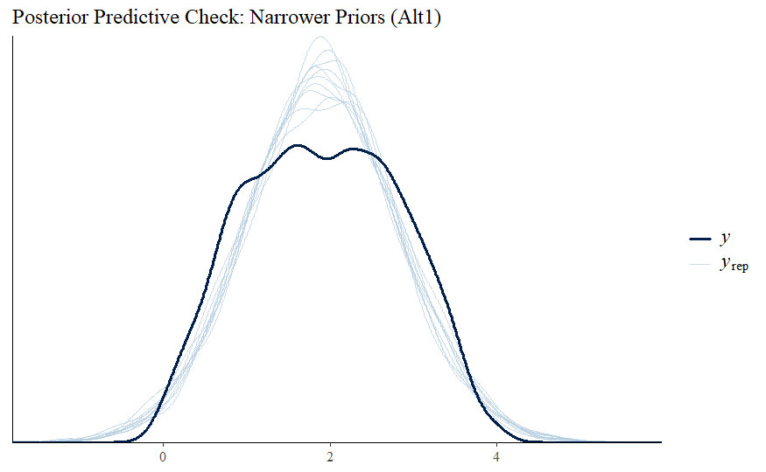
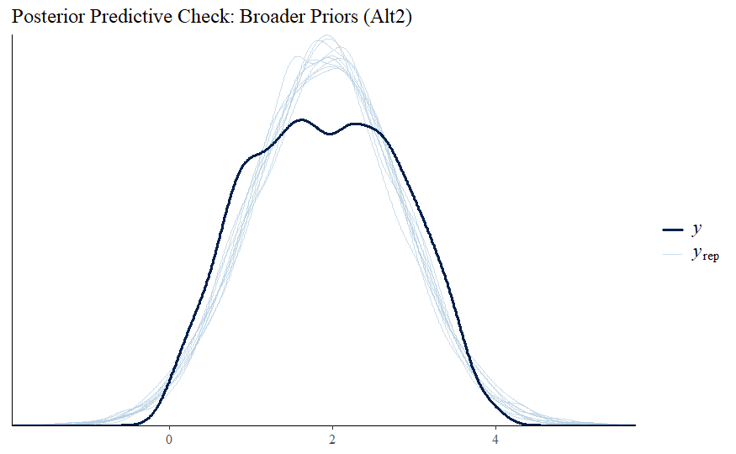
5) Prior Sensitivity Analysis
For Study Habits Cluster
GPA ~ Gender + ParentalEducation + ParentalSupport + Extracurricular + Sports + Music + Volunteering + Ethnicity + (1 | StudyHabitsGroup)
Figure 5.1: Posterior Predictive Check: Narrower Priors
Figure 5.2: Posterior Predictive Check: Broader Priors
("normal(0, 1)", class = "b"),
("cauchy(0, 1)", class = "sd"),
("student_t(3, 0, 2)", class = "Intercept")
("normal(0, 10)", class = "b"),
("cauchy(0, 1)", class = "sd"),
("student_t(3, 0, 2)", class = "Intercept")

Slide 7
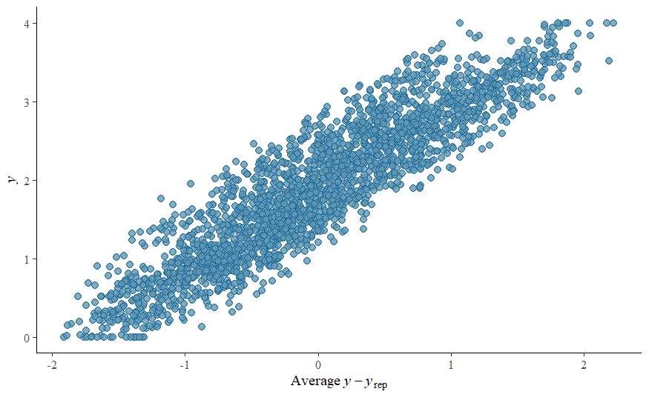

5) Prior Sensitivity Analysis (cont.)
Predictive residuals of Model
Figure 5.3: Residual Plot: Narrower Priors
Figure 5.4: Residual Plot: Broader Priors

Slide 8
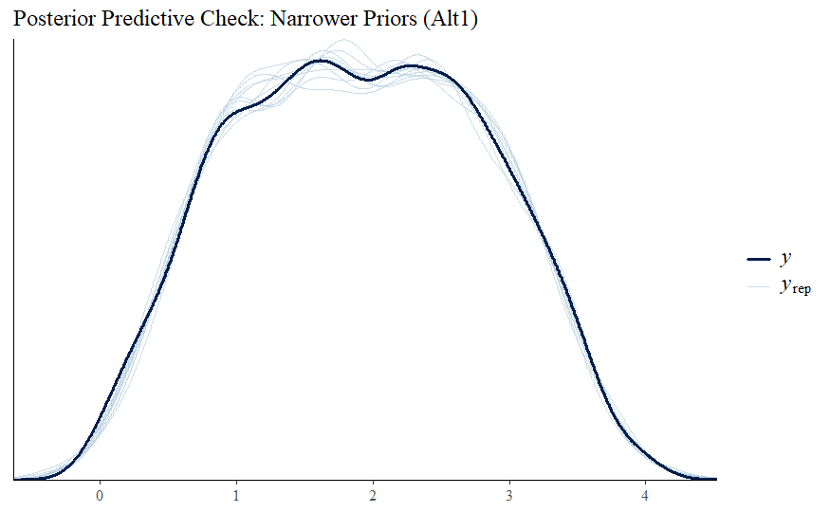
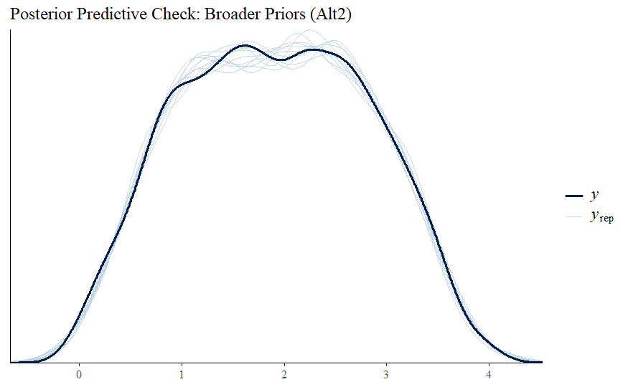
5) Prior Sensitivity Analysis (cont.)
For Activity Group Cluster
GPA ~ Gender + ParentalEducation + ParentalSupport + StudyTimeWeekly + Absences + Tutoring + Ethnicity + (1 | ActivityGroup)
Figure 5.5: Posterior Predictive Check : Narrower Priors
Figure 5.6: Posterior Predictive Check : Broader Priors
("normal(0, 1)", class = "b"),
("cauchy(0, 1)", class = "sd"),
("student_t(3, 0, 2)", class = "Intercept")
("normal(0, 1)", class = "b"),
("cauchy(0, 1)", class = "sd"),
("student_t(3, 0, 10)", class = "Intercept")

Slide 9
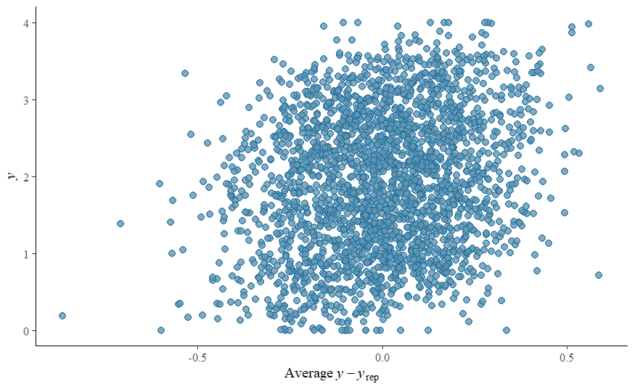
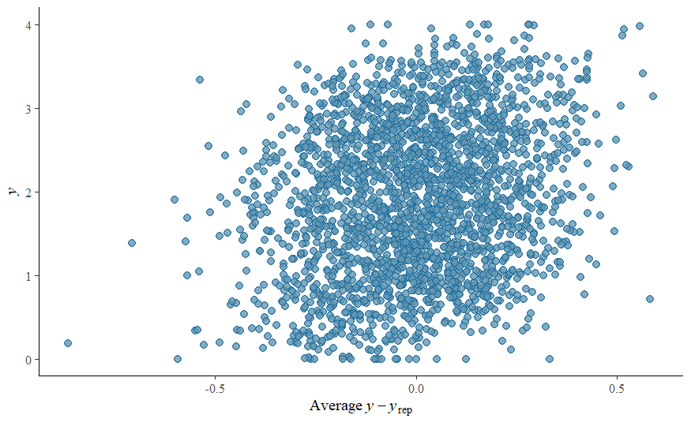
5) Prior Sensitivity Analysis (cont.)
Predictive residuals of Model
Figure 5.7: Residual Plot: Narrower Priors
Figure 5.8: Residual Plot: Broader Priors

Slide 10
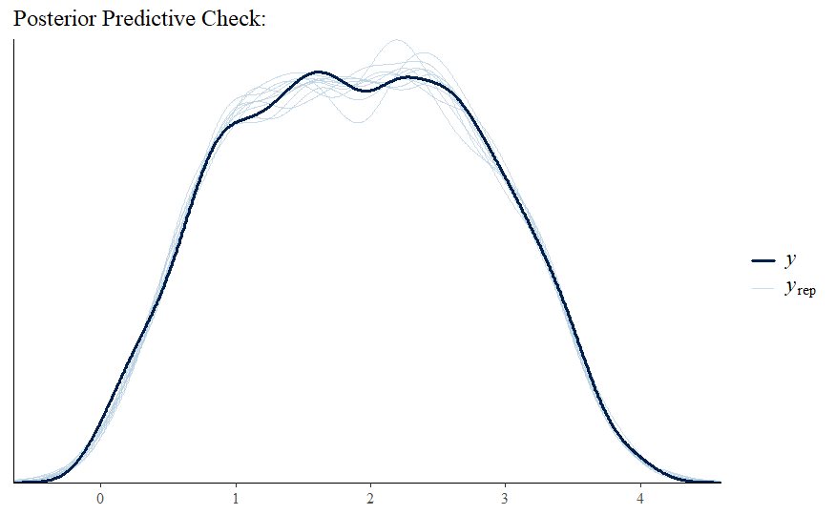
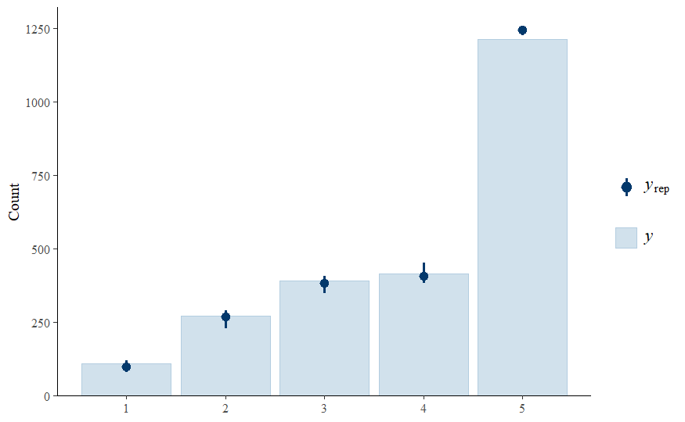
6) Model Comparison
Continuous (GPA)
Ordinal (GradeClass)
GPA ~ Gender + ParentalEducation + ParentalSupport + StudyTimeWeekly + Absences + Tutoring + Ethnicity +
(1 | ActivityGroup)
GradeClass ~ Gender + ParentalEducation + ParentalSupport + StudyTimeWeekly + Absences + Tutoring + Ethnicity +
(1 | ActivityGroup)
("normal(0, 1)", class = "b"),
("cauchy(0, 1)", class = "sd"),
("student_t(3, 0, 10)", class = "Intercept")
Figure 6.1: Posterior Predictive Check of Continuous model on GPA
Figure 6.2: Posterior Predictive Check of Ordinal model on GradeClass

Slide 11
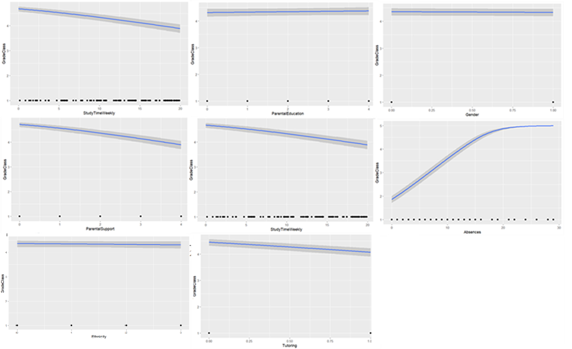
7) Conditional Effects (Ordinal)
Figure 6.3: Conditional Effects on continuous model. Gender, Parental Education and Ethnicity have very low effect.

Slide 12
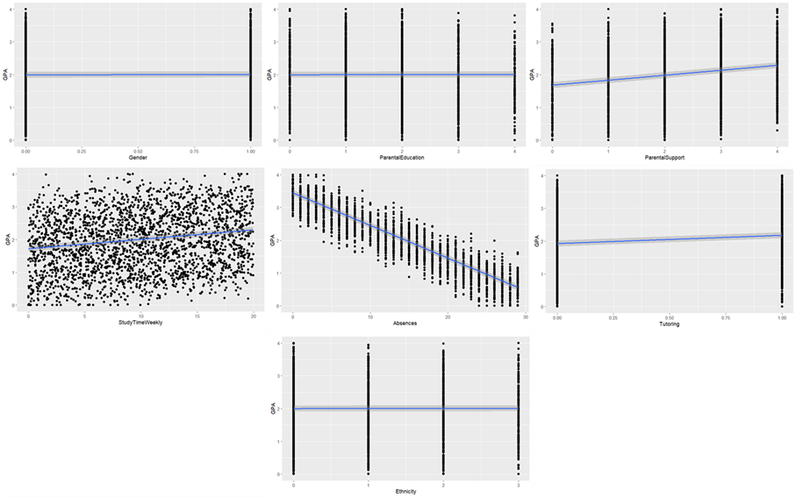
7) Conditional Effects (Continuous)
Figure 6.4: Conditional Effects on continuous model. Gender, Parental Education and Ethnicity have very low effect.

Slide 13
Discussion
Model Comparison (LOO)
Continuous | Estimae | SE |  | Ordinal | Estimate | SE
elpd_loo | 483.4 | 34 |  | elpd_loo | -1898.1 | 64.6
p_loo | 24.4 | 1.3 |  | p_loo | 19.3 | 0.9
looic | -966.7 | 68.1 |  | looic | 3796.1 | 129.2
Table: Model Comparison

Slide 14
Summary
Objective: Predict student performance (Grades & GPA).
Methodology: Hierarchical models (logit & continuous).
Key Findings:
Continuous model outperformed ordinal (higher 𝑒𝑙𝑝𝑑𝑙𝑜𝑜, lower 𝑙𝑜𝑜𝑖𝑐).
Significant predictors: Parental Support, Study Time, Tutoring, Absences.
Minimal effects: Gender, Parental Education, Ethnicity.
Implications: Focus on impactful predictors to enhance performance.

Slide 15
References
https://paulbuerkner.com/software/brms-book/brms-book.pdf
https://cran.r-project.org/web/packages/brms/vignettes/brms_overview.pdf

Slide 16

Any Questions

